Slide 1
Charts

Slide 2
 | 1^{st (most} Fem)* | 2^{nd (M and N)} | 3^{rd (All} genders) | 4^{th (m}/n)* | 5th (Most Fem)*
Nom Singular | a | us/r (um) | anything | us (ū) | ēs
Genitive sing | ae | ī | is | ūs | eī
Dative sing | ae | ō | ī | uī (ū) | eī
Accusative s | am | um | em (nom) | um (ū) | em
Ablative sing | ā | ō | e (ī) | ū | ē
Nom Plural | ae | ī (a) | ēs (a/ia) | ūs (ua) | ēs
Genitive Pl | ārum | ōrum | um (ium) | uum | ērum
Dative Pl | īs | īs | ibus | ibus | ēbus
Accusative Pl | ās | ōs (a) | ēs/īs (a/ia) | ūs (ua) | ēs
Ablative Pl | īs | īs | ibus | ibus | ēbus

Slide 3
 | 1^{st (most} Fem)* | 2^{nd (M and N)} | 3^{rd (All} genders) | 4^{th (m}/n)* | 5th (Most Fem)*
Nom Singular | via | filius atrium | pax iter | manus cornu | rēs
Genitive sing | viae | filiī atrii | pacis itineris | manūs cornus | reī
Dative sing | viae | filiō atrio | pacī itineri | manuī cornū | reī
Accusative s | viam | filium atrium | pacem iter | manum cornū | rem
Ablative sing | viā | filiō atrio | pace itinere | manū cornu | rē
Nom Plural | viae | filiī atria | pacēs itinera | manūs cornua | rēs
Genitive Pl | viārum | filiōrum atriorum | pacum itinerum | manuum cornuum | rērum
Dative Pl | viīs | filiīs atriis | pacibus itineribus | manibus cornibus | rēbus
Accusative Pl | viās | filiōs atria | pacēs/īs itinera | manūs cornua | rēs
Ablative Pl | viīs | filiīs atriis | pacibus itineribus | manibus cornibus | rēbus

Slide 4
 | 1st Per | 2nd Per | 3rd Masc | 3rd Fem | 3rd Neuter
Nom Singular | ego / I | tu / you | is / he | ea / she | id / it
Genitive sing | mei / of me | tui / of you | eius / his | eius / her | eius / its
Dative sing | mihi / to me | tibi / to you | ei / to him | ei / to her | ei / to it
Accus sing | me / me | te / you | eum / him | eam / her | id / it
Ablative sing | me | te | eo | ea | eo
Nom Plural | nos / we | vos / ya’ll | ei / they | eae / they | ea / those things
Genitive Pl | nostrum | vestrum | eorum / their | earum | eorum
Dative Pl | nobis / to us | vobis / to y’all | eis / to them | eis / to them | eis / to those things
Accus Pl | nos / us | vos / ya’ll | eos / them | eas | ea / those things
Ablative Pl | nobis | vobis | eis | eis | eis

Slide 7
 | MASC | FEM | NEUT |  | MASC | FEM | NEUT
NOM | hic | haec | hoc |  | ille | illa | illud
GEN | huius | huius | huius |  | illīus | illīus | illīus
DAT | huic | huic | huic |  | illī | illī | illī
ACC | hunc | hanc | hoc |  | illum | illam | illud
ABL | hōc | hāc | hōc |  | illō | illā | illō
NOM | hī | hae | haec |  | illī | illae | illa
GEN | hōrum | hārum | hōrum |  | illōrum | illārum | illōrum
DAT | hīs | hīs | hīs |  | illīs | illīs | illīs
ACC | hōs | hās | haec |  | illōs | illās | illa
ABL | hīs | hīs | hīs |  | illīs | illīs | illīs
SINGULAR
PLURAL
7

Slide 8
 | MASC | FEM | NEUT |  | MASC | FEM | NEUT
NOM | iste | ista | istud |  | ille | illa | illud
GEN | istīus | istīus | istīus |  | illīus | illīus | illīus
DAT | istī | istī | istī |  | illī | illī | illī
ACC | istum | istam | istud |  | illum | illam | illud
ABL | istō | istā | istō |  | illō | illā | illō
NOM | istī | istae | ista |  | illī | illae | illa
GEN | istōrum | istārum | istōrum |  | illōrum | illārum | illōrum
DAT | istīs | istīs | istīs |  | illīs | illīs | illīs
ACC | istōs | istās | ista |  | illōs | illās | illa
ABL | istīs | istīs | istīs |  | illīs | illīs | illīs
8

Slide 9
Pronouns | Masculine | Feminine | Neuter
NOMINATIVE | qui | quae | quod
GENITIVE | cuius | cuius | cuius
DATIVE | cui | cui | cui
ACCUSATIVE | quem | quam | quod
ABLATIVE | quo | qua | quo
NOMINATIVE | qui | quae | quae
GENITIVE | quorum | quarum | quorum
DATIVE | quibus | quibus | quibus
ACCUSATIVE | quos | quas | quae
ABLATIVE | quibus | quibus | quibus
SINGULAR
PLURAL

Slide 10
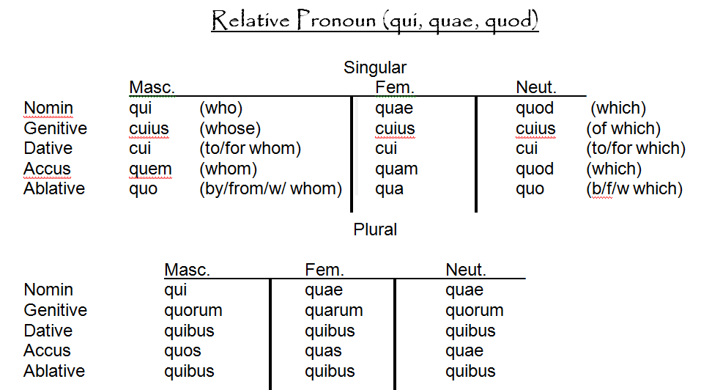

Slide 11
Indicative Active Verb Endings
 | Present | Imperf. | Future | Perfect | Pluperf. | Fut. Prf.
1st S | -o | -bam | -bo / -am | -i | -eram | -ero
2nd S | -s | -bas | -bis / -es | -isti | -eras | -eris
3rd S | -t | -bat | -bit / -et | -it | -erat | -erit
1st Pl | -mus | -bamus | -bimus / -emus | -imus | -eramus | -erimus
2nd Pl | -tis | -batis | -bitis / etis | -istis | -eratis | -eritis
3rd Pl | -nt | -bant | -bunt / -ent | -erunt | -erant | -erint
Indicative Passive Verb Endings
 | Present | Imperf. | Future | Perfect | Pluperf. | Fut. Prf.
1st S | -r | -bar | -bor / -ar | PPP + sum | PPP + eram | PPP + ero
2nd S | -ris | -baris | -beris / -eris | PPP + es | PPP + eras | PPP + eris
3rd S | -tur | -batur | -bitur / -etur | PPP + est | PPP + erat | PPP + erit
1st Pl | -mur | -bamur | -bimur / -emur | PPP + sumus | PPP + eramus | PPP + erimus
2nd Pl | -mini | -bamini | -bimini / -emini | PPP + estis | PPP + eratis | PPP + eritis
3rd Pl | -ntur | -bantur | -buntur / -entur | PPP + sunt | PPP + erant | PPP + erint

Slide 12
Subjunctive Active Verb Endings
 | Present | Imperf. | Perfect | Pluperf.
1st S | New Vowel (s) + m | Infinitive + m | -ero | -issem
2nd S | New Vowel (s) +s | Infinitive + s | -eris | -isses
3rd S | New Vowel (s) +t | Infinitive + t | -erit | -isset
1st Pl | New Vowel (s) +mus | Infinitive +mus | -erimus | -issemus
2nd Pl | New Vowel (s) +tis | Infinitive +tis | -eritis | -issetis
3rd Pl | New Vowel (s) +nt | Infinitive +nt | -erint | -issent
Subjunctive Passive Endings
 | Present | Imperf. | Perfect | Pluperf.
1st S | New Vowel (s) + r | Infinitive + r | PPP + ero | PPP + essem
2nd S | New Vowel (s) + ris | Infinitive +ris | PPP + eris | PPP + esses
3rd S | New Vowel (s) + tur | Infinitive +tur | PPP + erit | PPP + esset
1st Pl | New Vowel (s) + mur | Infinitive +mur | PPP + erimus | PPP +essemus
2nd Pl | New Vowel (s) +mini | Infinitive +mini | PPP + eritis | PPP + essetis
3rd Pl | New Vowel (s) + ntur | Infinitive +ntur | PPP + erint | PPP + essent

